Slide 1
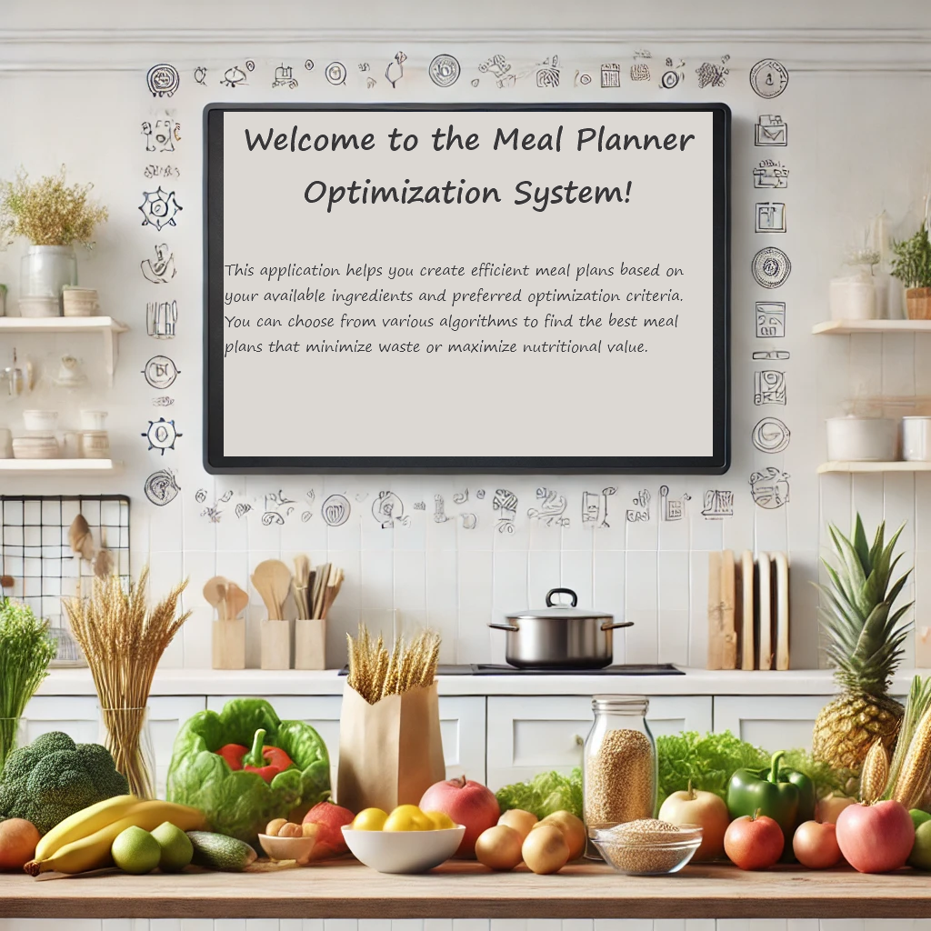

This is Your Presentation Title
Welcome to the Meal Planner
Introduction to AI 2024
Mor Ben Ami, Nadav Lederman, Daniel Gibor

Slide 2
Motivation
Up to 40% of food in the U.S. goes uneaten annually.
Environmental Benefits
Waste Reduction: Less food ending up in landfills.
Resource Conservation: Saving water and energy used in food production.
Economic Benefits
Cost Savings: Reduce expenses related to food purchasing and disposal.
Efficiency: Better inventory management leads to operational savings.
Societal Contribution
Sustainability: Promotes responsible consumption practices.
Practical Applications: Useful for households and commercial kitchens alike.

Slide 3
Project Objectives
Develop an intelligent system for optimizing ingredient usage
Reduce waste, save costs, and lessen environmental impact
Create a flexible platform for personalized meal planning

Slide 4
Previous work
Uses,Algorithms and Methods:
USDA's Thrifty Food Plan (since 1975)
School lunch menu optimization
Standard linear programming
Individual diet modelling

Slide 5
Assumptions and Limitations
Meal preparation time is not considered a constraint
Future meal shelf life not factored into planning
Datasets of varying sizes used for testing
Accurate data on ingredient expiration dates and nutritional values

Slide 6
Key Features
Flexible architecture for future enhancements
Ability to incorporate nutritional balance
Potential for dietary restriction constraints
Scalable to handle various optimization goals
User-friendly interface for non-technical users

Slide 7
Methodology Overview
State Definition
Recipes chosen so far as part of meal plan, and all Products left. Each product has Name, Id, Quantity and Expiration date.
Goal State
Given a number of days to plan meals, and number of meals per day we reach this state once we have planned all recipes.
Actions
Represent recipes, Actions update state, and actions can have multiple values depending on problem definition.

Slide 8
Algorithms Implemented
Greedy
Simulated
Annealing
Reinforcement Learning

Slide 9
Greedy Algorithm
Greedy Algorithm Makes best choice at each step without looking ahead
Checks available actions, picks highest scoring action, updates state
Used as the baseline.

Slide 10
Simulated Annealing
Starts with a random solution.
Makes small changes, accepting improvements and sometimes worse solutions.
Temperature decreases over time, reducing acceptance of worse solutions,

Slide 11
Reinforcement Learning (Q-learning)
Learns from repeated attempts
Updates Q-table storing the expected value of each action in each state
Balances exploration and exploitation (epsilon-greedy)

Slide 12
Problem Types
Count Expired Items
Minimize Waster
Meal Parameters

Slide 13
Count Expired Items
Score: 1 / (expired count + 1)
Focuses on minimizing the number of expired items

Slide 14
Minimize Waster
Score: 1 / (expired count + 1) + Σ[1 / (expiration date - current date + 1)]
Prioritizes using ingredients closer to expiration
Provides continuity to choices of actions over time

Slide 15
Meal Parameters
Optimizes based on recipe parameters (e.g., taste, preparation time).
Combined with the minimize waste problems for multi-objective optimization.

Slide 16
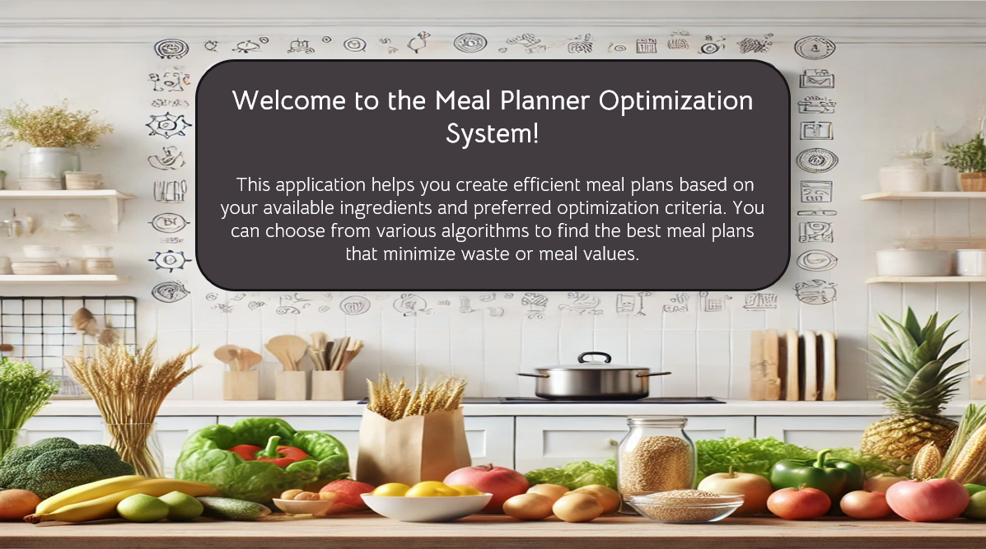
User Interface

Slide 17
Demonstration !!!!

Slide 18
Evaluation
Two Key parameters:
Score rating on each problem
Runtime

Slide 19
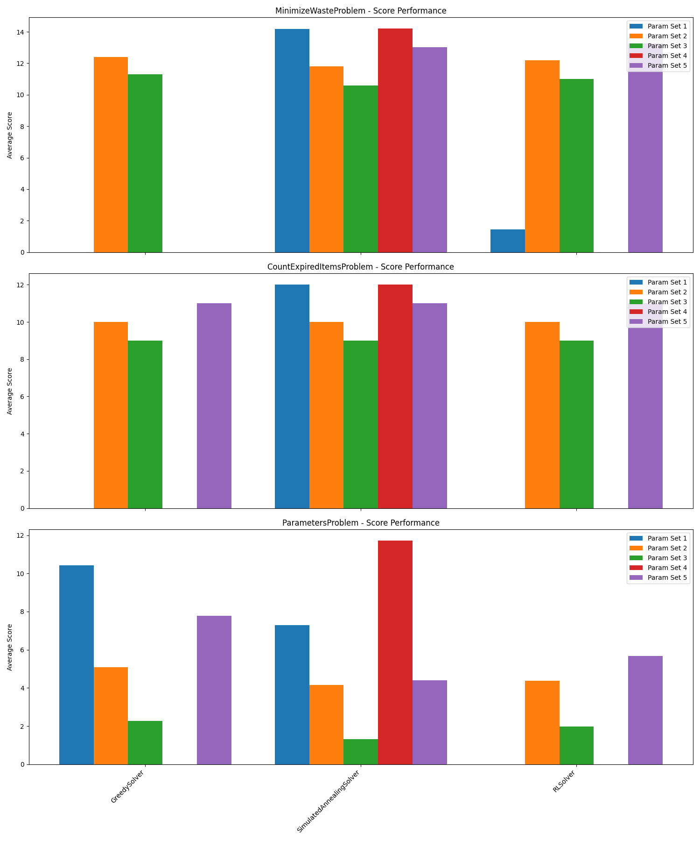
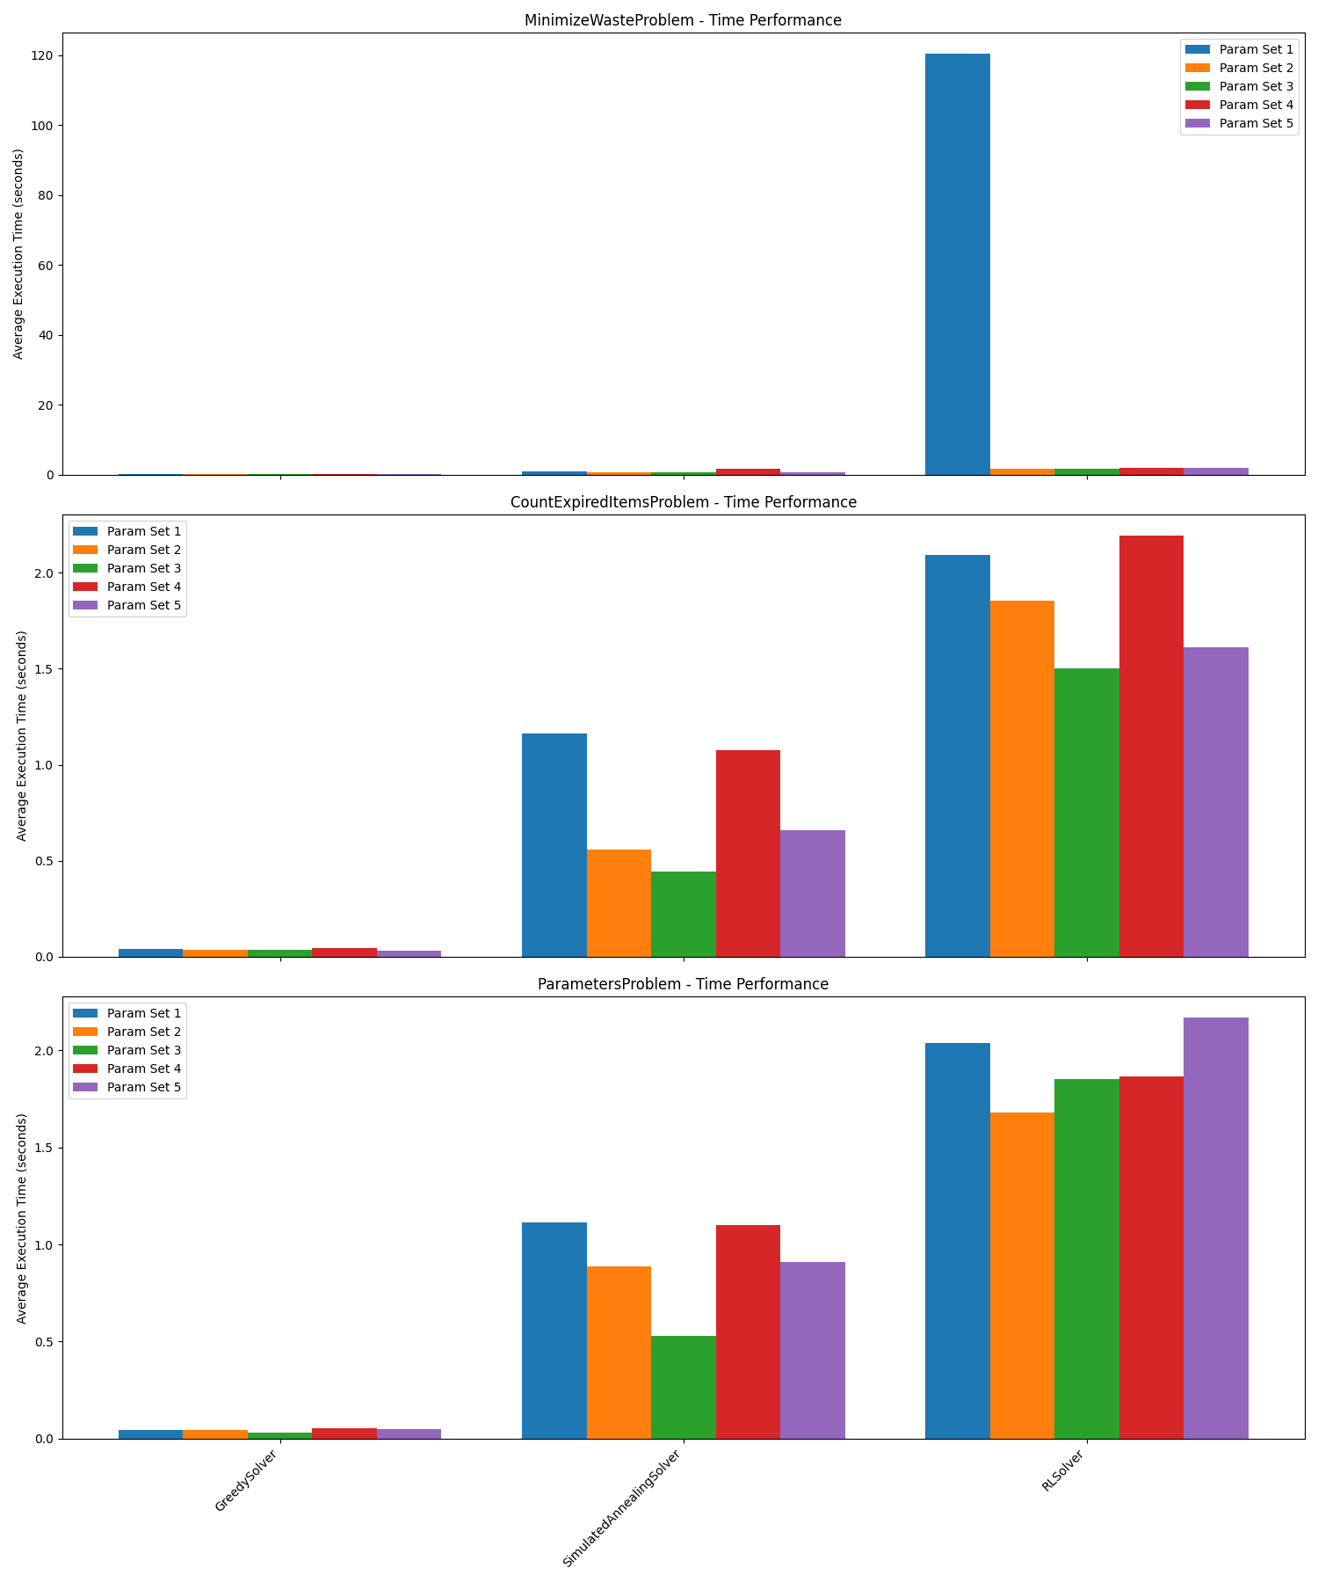
Results

Slide 20
Future Work
Expand the dataset to include more detailed nutritional information
Implement constraints for dietary restrictions
Optimize for additional factors (e.g., cost, environmental impact)
Allow misspelling of product inputs.
Use recommender system logic for personalized recipes.

Slide 21
Conclusion – What we learned
Simple VS Complex algorithm implementation
AI Problem project structaring for experementation

Slide 22
Thank you!

